Slide 1

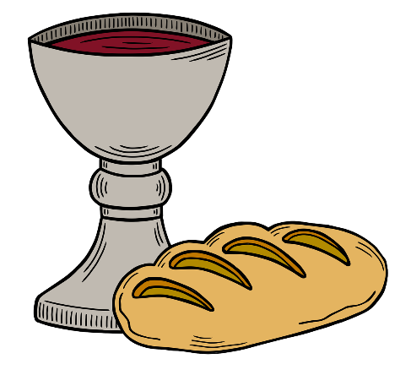
Presider: The Lord is here!
All: His Spirit is with us.
Lift up your hearts.
We lift them to the Lord.
We give thanks to God.
We praise and magnify the Lord.

Slide 2
God you are good,
you are gracious,
you are generous.
You created all that is,
formed us in your own image
and came to us in Jesus Christ.

Slide 3
Sharing our humanity,
Christ lived and walked,
he proclaimed the kingdom,
in who he was and what he did.

Slide 4
Through Christ
you send your Spirit,
teaching us and
reminding us of Christ,
and calling us into communion
with you and each other.

Slide 5
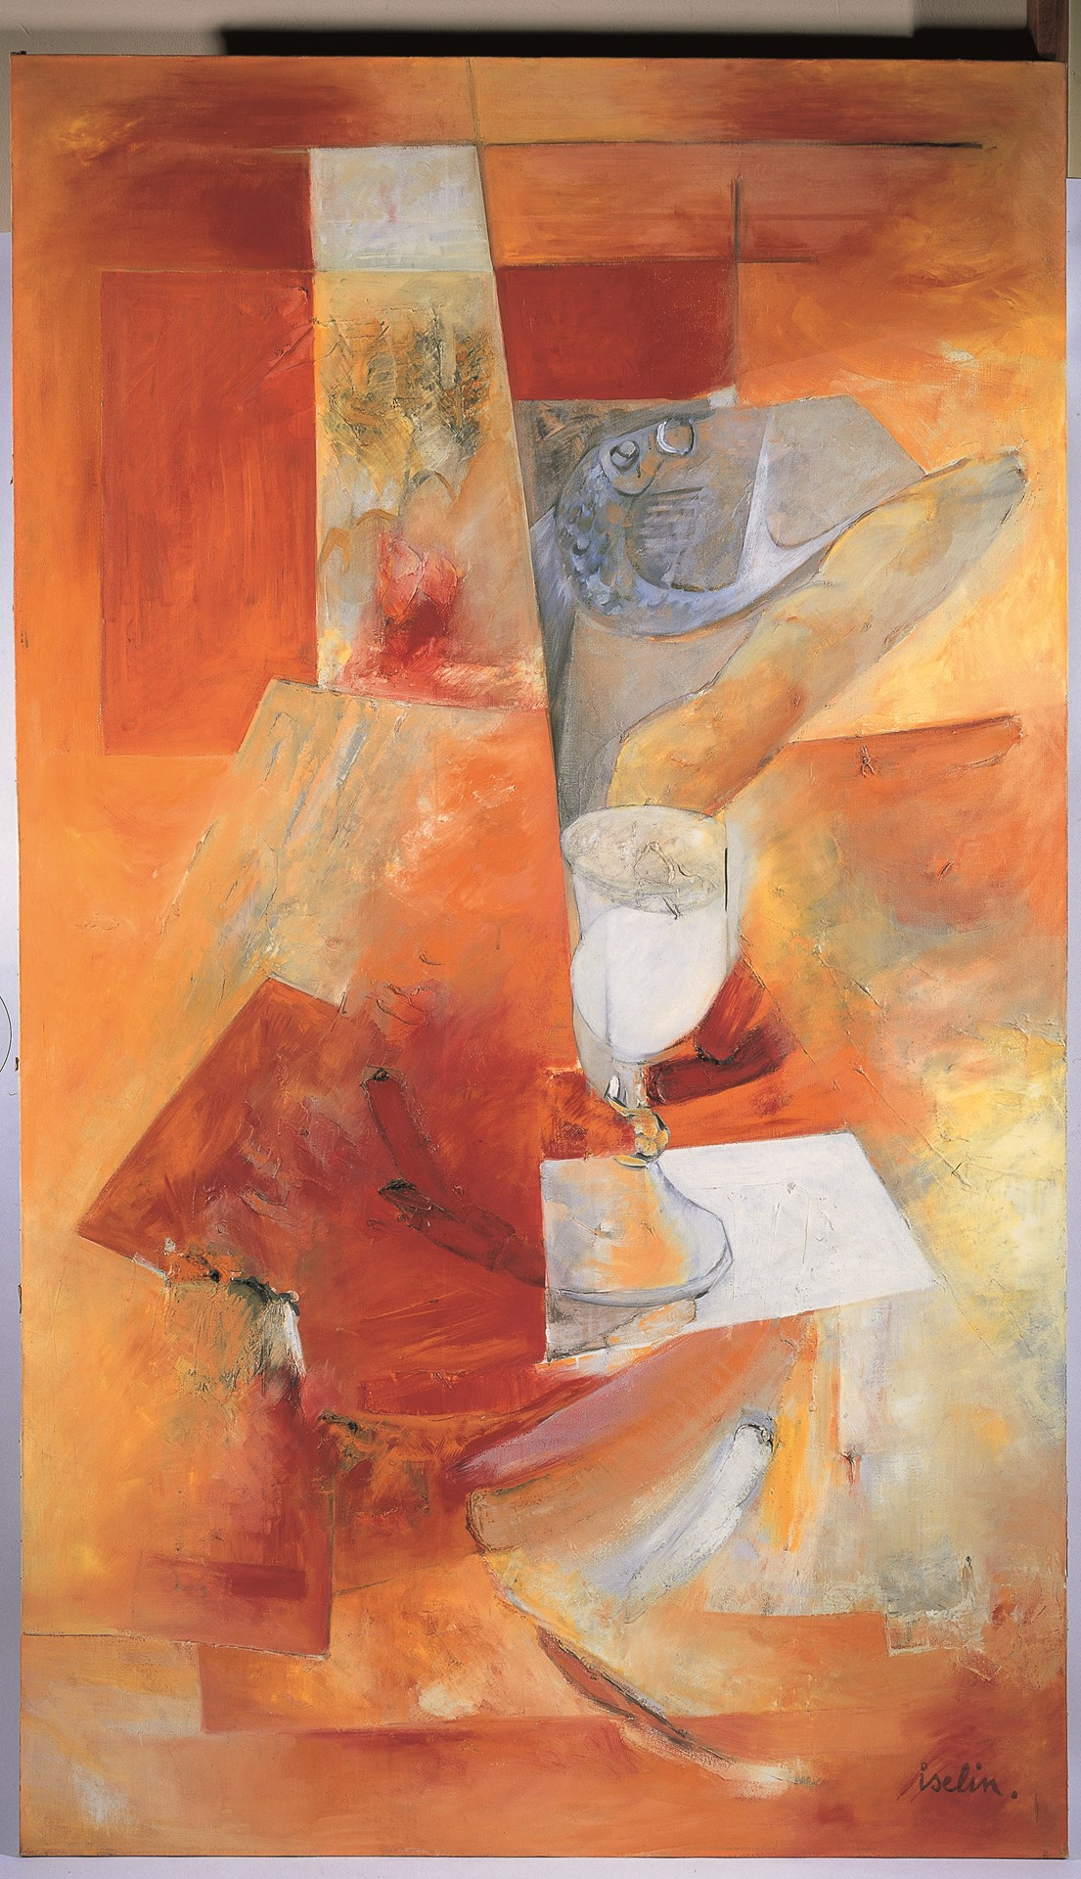
Matthew 26
v26-29

Slide 6
In remembrance
of Christ’s life and death,
In celebration of the new beginning brought forth
through Christ’s resurrection,
And by the outpouring of your
Holy Spirit,
We come before you to receive your grace.

Slide 7
Today, in this moment,
may our eyes
be opened to your presence,
may our hearts
know the light of your love,
may our souls
know your steadfast grace.

Slide 8
Pour out your Spirit
on these gifts and on us all,
that we may be united with Christ, with each other,
and with the whole of creation forever.

Slide 9
The Elements
of Communion
Jaques Iselin
Methodist Modern
Art Collection
© Trustees for Methodist Church Purposes

Slide 10
God of generosity and grace,
We thank you that wherever we are,
you meet with us,
strengthen us
and sustain us.

Slide 11
We celebrate that by being part of your body,
the body of Christ,
we are united as one,
by your Holy Spirit. Amen
Acknowledgements
Adapted by Rev Daniel J Balsdon from the Methodist Worship Book, Order 1, p191-197, ©1999 Trustees for Methodist Church Purposes (COM004.4, June 2023)
Biblical text from New International Version
Images used under creative commons licence, unless otherwise acknowledged.

