Slide 1

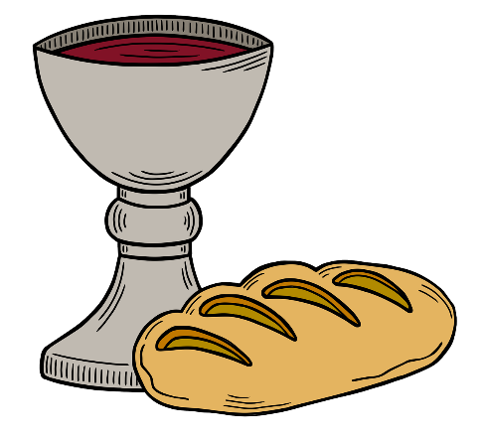
Presider: The Lord is here!
All: His Spirit is with us.
Lift up your hearts.
We lift them to the Lord.
We give thanks to God.
We praise and magnify the Lord.

Slide 2
God you are good,
you are gracious,
you are generous.
You created all that is,
formed us in your own image
and came to us in Jesus Christ.

Slide 3
Sharing our humanity,
Christ lived and walked,
he proclaimed the kingdom,
in who he was and what he did.
Through Christ you send your Spirit,
teaching us
and reminding us of Christ,
and calling us into communion
with you and each other.

Slide 4
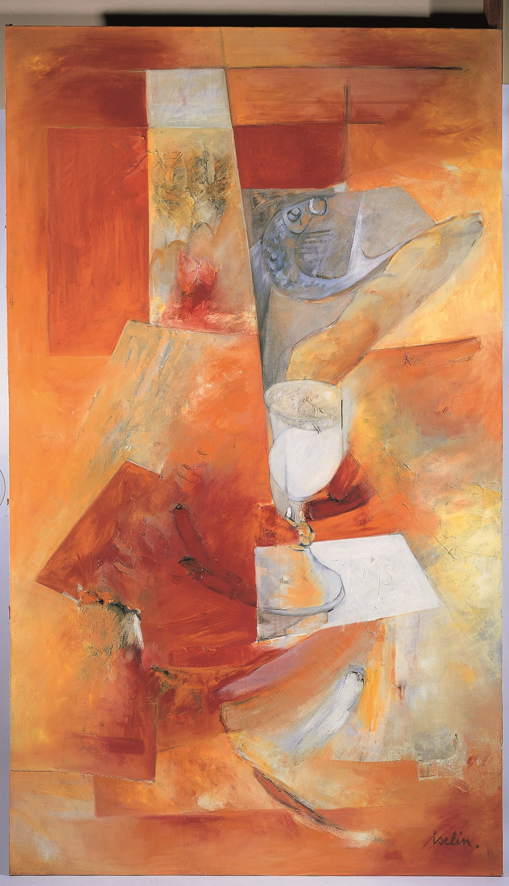
Matthew 26:26-29

Slide 5
In remembrance
of Christ’s life and death,
In celebration of the new beginning brought forth
through Christ’s resurrection,
And by the outpouring of
your Holy Spirit,
We come before you
to receive your grace.

Slide 6
Today, in this moment,
may our eyes
be opened to your presence,
may our hearts
know the light of your love,
may our souls
know your steadfast grace.

Slide 7
Pour out your Spirit
on these gifts and on us all,
that we may be united with Christ,
with each other,
and with the whole of creation forever.

Slide 8
The Elements of Communion
Jaques Iselin
Methodist Modern Art Collection
© Trustees for Methodist Church Purposes

Slide 9
God of generosity and grace,
We thank you that wherever we are,
you meet with us,
strengthen us and sustain us.
We celebrate that by being part of your body, the body of Christ,
we are united as one,
by your Holy Spirit. Amen

Slide 10
Acknowledgements
Adapted by Rev Daniel J Balsdon from the Methodist Worship Book, Order 1, p191-197,
©1999 Trustees for Methodist Church Purposes (COM004.4, June 2023)
Biblical text from New International Version
Images used under creative commons licence, unless otherwise acknowledged.

